Slide 1

Phonetics in Motion
A Lyrical Journey Through the Place of Articulation
Class Quiz & Exercise

Slide 2



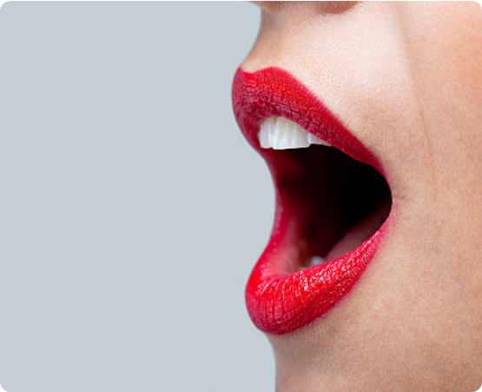
The Song: Verse 1 & Chorus
[Verse] Lips together making the start Bilabials popping like a heart Puh puh buh buh They hit so true The sound begins The breath breaks through [Chorus] Place of articulation A dance of the tongue From lips to the roof where the songs are sung Place of articulation It's where we meet Phonetics in motion The rhythm’s heartbeat

Slide 3


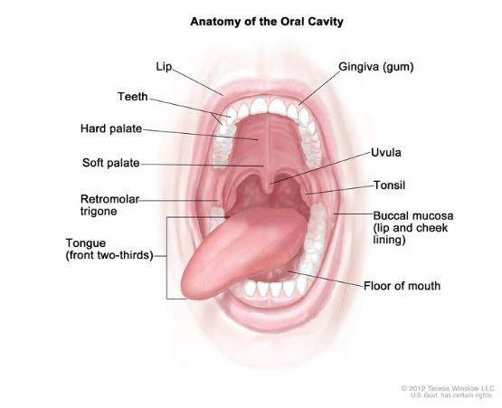
The Song: Verse 2, Pre-chorus & Bridge
[Verse 2] Dentals now, A subtle grace Tip of the tongue, Just a trace Thuh thuh... Thin threads unwind [Prechorus] From teeth to alveolars, We glide Tuh tuh, Duh duh, Sound worldwide [Bridge] Palatals slide like a whispered breeze Yuh yuh, Shh shh, Soft melodies Velars kick in, A guttural hue Kuh kuh, Guh guh, Bold and true

Slide 4

Question 1
The Core Concept
What core linguistic concept is described in the Chorus as the "rhythm’s heartbeat" and "dance of the tongue"?
A Manner of Articulation
B Place of Articulation
C Vocal Cord Vibration
D Vowel Quality

Slide 5
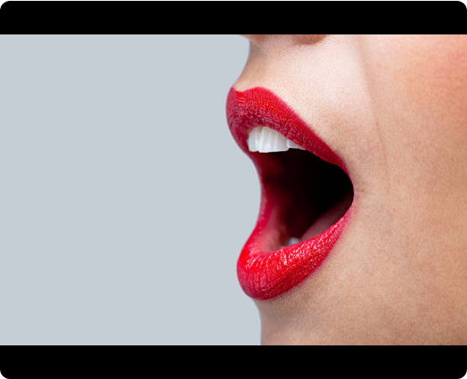
Question 2
Bilabial Mechanics
According to Verse 1, which articulators are used for the Bilabial sounds that are made by "Lips together making the start"?
A The tongue tip and the upper teeth
B The lower lip and upper teeth
C Both lips
D The back of the tongue and soft palate

Slide 6

Question 3
Identifying Sounds
The sounds represented by "Puh puh buh buh" in Verse 1 are examples of which place of articulation?
A Dental
B Alveolar
C Bilabial
D Palatal

Slide 7
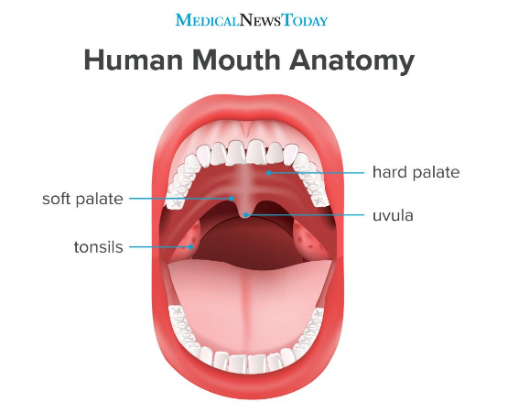
Question 4
Dental Articulation
Verse 2 describes Dentals as using the "Tip of the tongue / Just a trace." For a dental sound, what does the tongue tip typically make contact with?
A The soft palate (velum)
B The hard palate
C The alveolar ridge
D The upper front teeth

Slide 8
Question 5
Alveolar Ridge Location
The Pre-chorus mentions gliding "From teeth to alveolars." Where is the alveolar ridge located in the mouth?
A At the very back of the throat
B The fleshy area behind the hard palate
C The bony ridge directly behind the upper front teeth
D The underside of the tongue

Slide 9

Question 6
Soft Melodies
Which sounds, described as "Soft melodies," are examples of the Palatal place of articulation in the Bridge?
A Puh puh and Buh buh
B Thuh thuh
C Yuh yuh and Shh shh
D Kuh kuh and Guh guh

Slide 10

Question 7
Palatal Movement
The song says Palatals slide "like a whispered breeze." This sensation is primarily due to the tongue body moving towards which part of the mouth?
A The soft palate (velum)
B The teeth
C The hard palate (roof of the mouth)
D The lower lip

Slide 11

Question 8
Velar Anatomy
The song says Velars "kick in / A guttural hue." For a velar sound, the back of the tongue approaches which structure?
A The alveolar ridge
B The hard palate
C The pharynx
D The soft palate (velum)

Slide 12

Question 9
Velar Sounds
What place of articulation is demonstrated by the "Bold and true" sounds of "Kuh kuh / Guh guh" in the Bridge?
A Dental
B Velar
C Bilabial
D Glottal

Slide 13

Question 10
Articulation Journey
Which two places of articulation are directly contrasted by the song's journey from "Lips together" (Verse 1) to "A guttural hue" (Bridge)?
A Dental and Alveolar
B Bilabial and Velar
C Palatal and Dental
D Alveolar and Bilabial

Slide 14




Bonus: The 11th Question
Your Task
The Challenge
Reply with exactly two sentences:
•
If you could write a new verse for the song about the Glottal place of articulation (the 'h' sound), what would it imply?
One describing the action.
•
One describing the sound's character.
Criteria: Make it Fun, Clever, and Perfect.

Slide 15
Answer Key
Q | Correct Answer | Key Concept
1 | B: Place of Articulation | Song Theme
2 | C: Both lips | Bilabial = Two lips
3 | C: Bilabial | /p/, /b/ sounds
4 | D: Upper front teeth | Dental targets
5 | C: Bony ridge behind teeth | Alveolar Ridge
6 | C: Yuh yuh and Shh shh | Palatal examples
7 | C: The hard palate | Tongue body to roof
8 | D: The soft palate (velum) | Velar targets
9 | B: Velar | /k/, /g/ sounds
10 | B: Bilabial and Velar | Front vs Back contrast

Slide 16


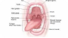

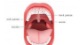


Image Sources
https://media.istockphoto.com/id/176769519/photo/womans-mouth-wide-open-with-red-lipstick.jpg?s=612x612&w=0&k=20&c=hTslccuzylallRVKMAW88fYHCwPv2yQtnxp5HlMRH1g=
Source: www.istockphoto.com
https://visualsonline.cancer.gov/retrieve.cfm?imageid=9259&dpi=72&fileformat=jpg
Source: visualsonline.cancer.gov
https://static.vecteezy.com/system/resources/previews/005/004/846/non_2x/abstract-sound-wave-curve-background-illustration-with-gold-and-blue-particles-creative-colorful-equalizer-and-spectrum-music-for-banner-and-poster-vector.jpg
Source: www.vecteezy.com
https://cdn-prod.medicalnewstoday.com/content/images/articles/326/326894/an-infographic-of-the-human-mouth.jpg
Source: www.medicalnewstoday.com
https://images.presentationgo.com/2025/04/abstract-sound-wave-background.png
Source: www.presentationgo.com
https://static.vecteezy.com/system/resources/previews/048/479/461/non_2x/abstract-wave-lines-luxury-shiny-gold-color-on-dark-blue-background-futuristic-flow-of-shining-gold-line-waves-suitable-for-banners-posters-covers-brochures-flyers-websites-vector.jpg
Source: www.vecteezy.com

